Slide 1
Chapter FOUR
QUEUE

Slide 2
Queue
Queue is an abstract data structure,
somewhat similar to Stacks.
Unlike stacks, a queue is open at both its ends. One end is always used to insert data (enqueue) and the other is used to remove data (dequeue).
Queue follows First-In-First-Out methodology, i.e., the data item stored first will be accessed first.

Slide 3

Queue
A real-world example of queue can be a single-lane one-way road, where the vehicle enters first, exits first. More real-world examples can be seen as queues at the ticket windows and bus-stops.

Slide 4
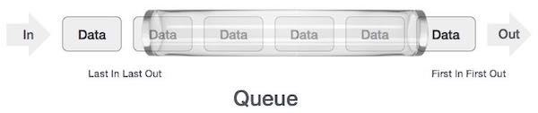
Queue Representation
As we now understand that in queue, we access both ends for different reasons. The following diagram given below tries to explain queue representation as data structure −

Slide 5
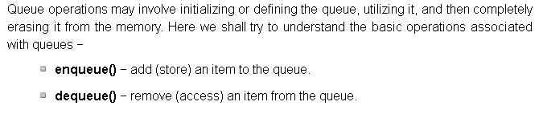
Basic Operations

Slide 6
Basic operations
Queue operation may involve initializing or defining the queue, utilizing it, and completely erasing it from the memory. Here we shall try to understand the basic operations associated with queues
enqueue(): add(store) an item to queue
Dequeue: remove(access) an item from the queue

Slide 7
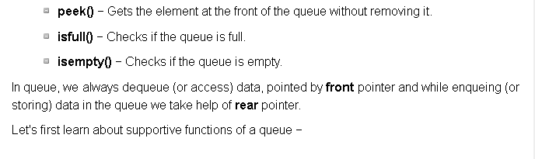
CONT’D

Slide 8
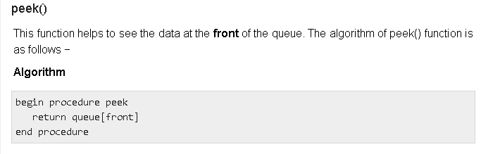
CONT’D

Slide 9
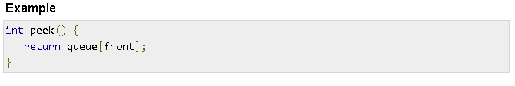
CONT’D

Slide 10
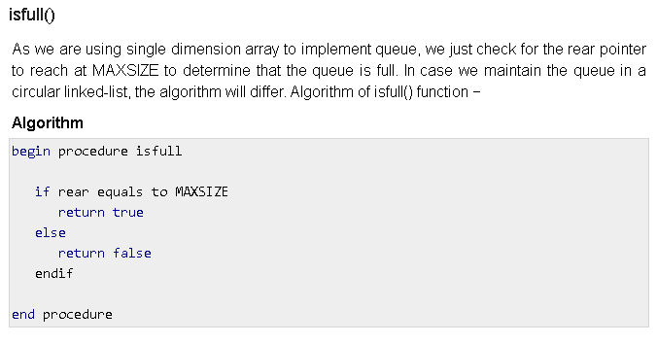
CONT’D

Slide 11
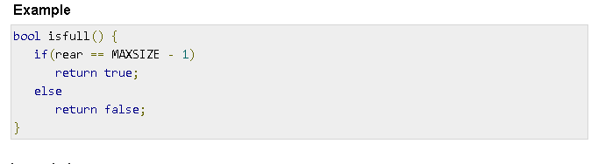
CONT’D

Slide 12
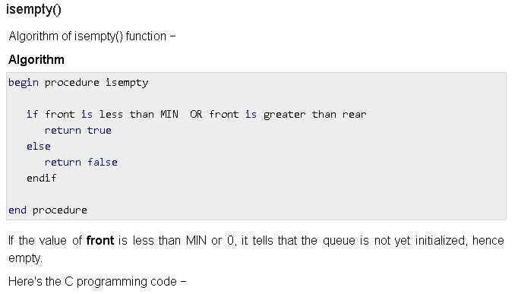
CONT’D

Slide 13
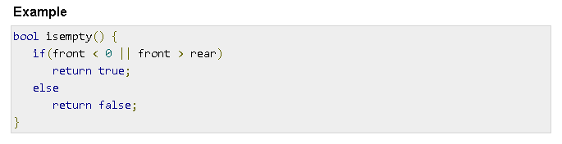
CONT’D

Slide 14
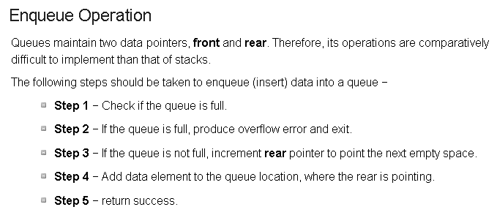
CONT’D

Slide 15
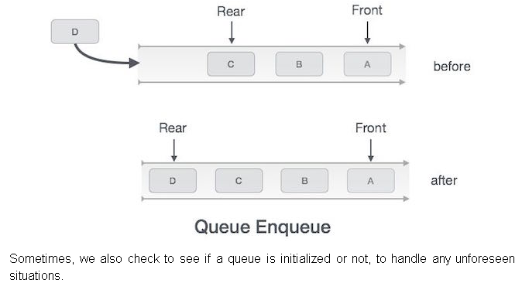
CONT’D

Slide 16
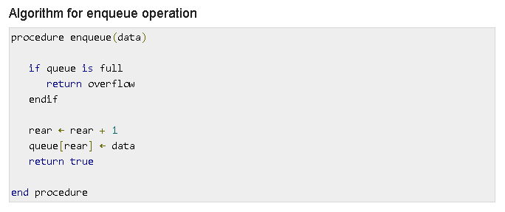
CONT’D

Slide 17
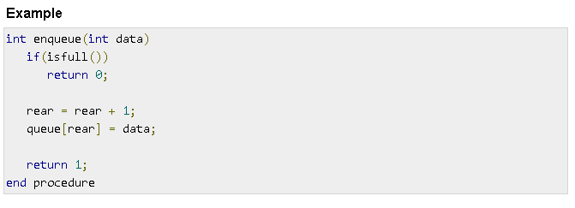
CONT’D

Slide 18
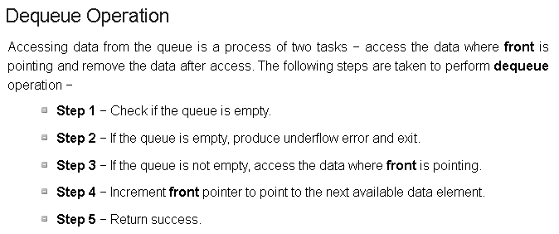
CONT’D

Slide 19
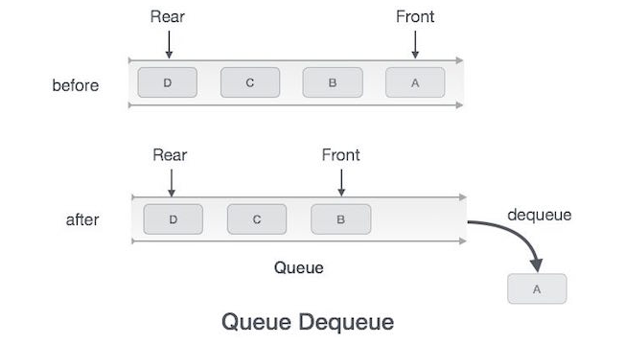
CONT’D

Slide 20
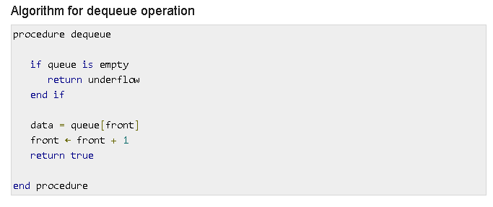
CONT’D

Slide 21
END

